Slide 1

T-Level year 2 Occupational specialist component
Section 1: TASK 1: ANALYSING THE PROBLEM AND
DESIGNING A SOLUTION

Slide 2
TASK 1: ANALYSING THE PROBLEM AND
DESIGNING A SOLUTION

Slide 3

Overall Business Context
You will need to provide an overall business context to show that you understand the task you have been asked to complete.
This shows to the client that you are aware of who they are & their needs.
In real world context, this can solve a lot of issues early on as they do not start work on something that the company does not need.
Overall Business Context | Explanation
Who is the client
What do they do?
What do they specialise in?
Where are they located?
What is their USP?
What is your job title / role?
What have they asked of you?
What staff do they have?
Who do you work for / job title?
Who is in your team?
What do they do?
Notes:
https://www.open.edu/openlearn/science-maths-technology/software-and-the-law/content-section-2.2

Slide 4
Research
Your research should consider how digital solutions are used to meet the needs of different users within the Food & Beverage Industry.
You will then use this research to create a design proposal for a digital solution & produce a set of design documents to showcase your solution to the client.
Overall Business Context | Explanation
Pre-Existing Coffee Shops (rivals)
How do they operate / run their business?
How does their online / digital side work?
Good things they do / things you would change?
(With their needs) What are your initial plans of how to approach this?
Screenshots of other businesses apps / your annotations / evaluations on it
Notes:
https://www.open.edu/openlearn/science-maths-technology/software-and-the-law/content-section-2.2

Slide 5
Market Research
Market Research | Explanation
Name
Personal Quote / Motto:
Bio:
Demographic:
Personality Traits:
Motivations:
Goals & Frustrations:
Preferred Brands & Influencers:
Now you have researched the brand, you need to focus on the customers themselves.
Who are they?
Who would you expect to use their shops / services?
Recap back to Unit 5 from last year.

Slide 6
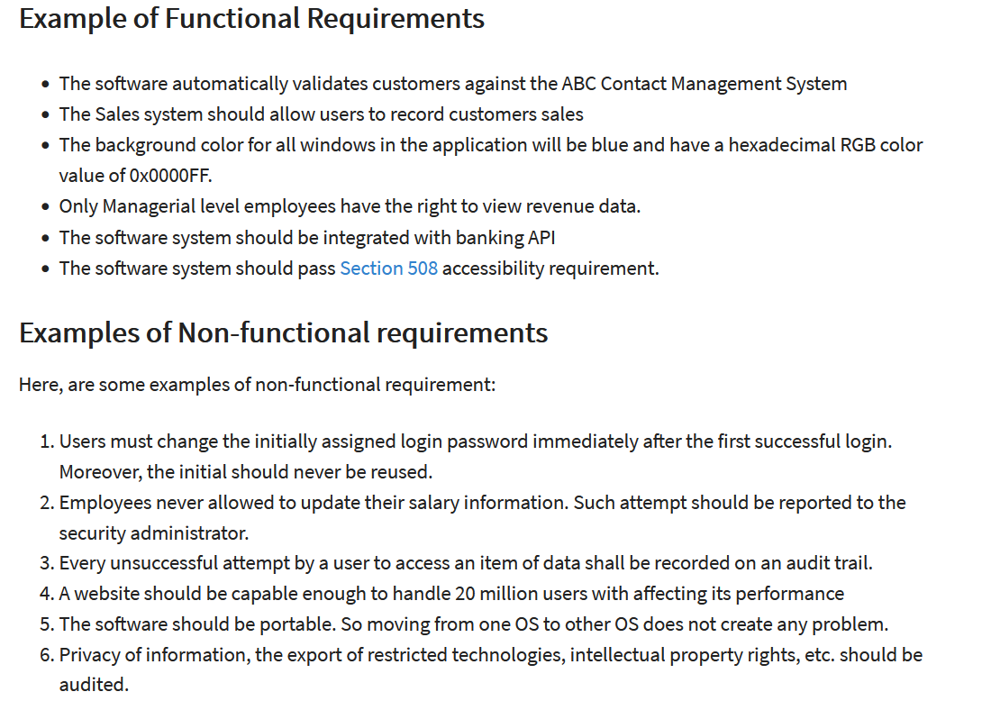
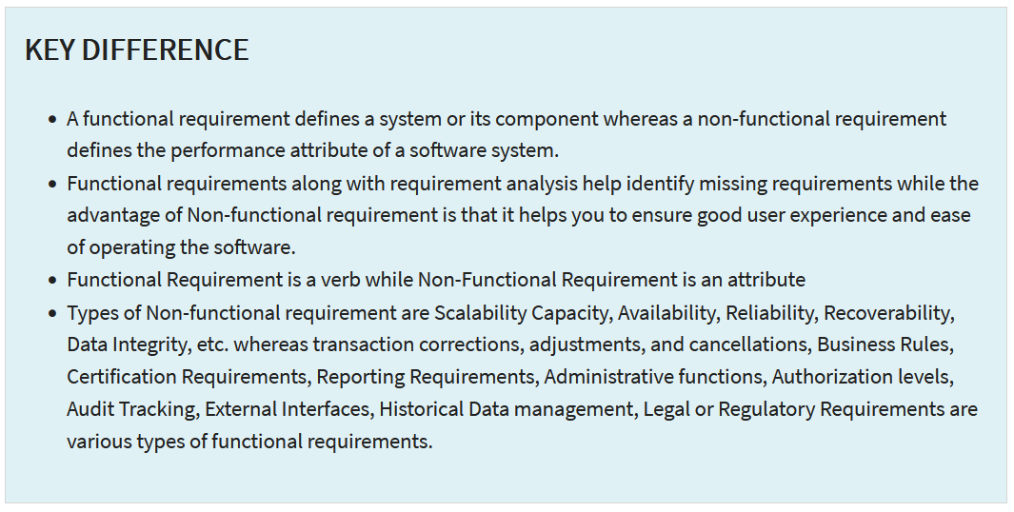
The functional & non-functional requirements of the solution
Notes:
https://www.open.edu/openlearn/science-maths-technology/software-and-the-law/content-section-2.2

Slide 7
A full list of the problems that need to be solved to meet all requirements.
Now, you need to list all the requirements of the project.
How are you going to approach them?
Any issues online similar to this you can find?
How were they dealt with?
Feel free to research these problems online to see how other companies deal with them.
Problem | Approach
Notes:
(EXAMPLES FROM A FITNESS APP DEVELOPER:)
Functional requirements:
● send email to a customer when they open a ToKa Fitness account
● user form-based authentication
● system for daily calories and movements, sleeping, fitness training and any other activates
● historical data to show trends
● transaction corrections, adjustment and cancellations
● external interface
● customer payment portal – secure considering all regulatory and legal requirements
● blog or forum for group support.
Non-functional requirements:
● performance good response time, throughput and utilisation
● scalability
● readability so should be able to view on any medium, e.g. tablet, mobile phone or desktop
● security ensure login details are secure and any important data used by the user or client
16
● usability.

Slide 8
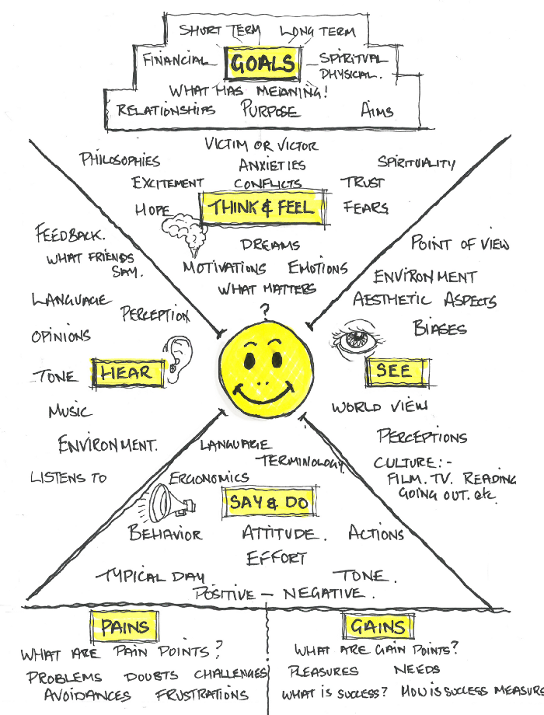
Empathy Mapping
Mapping is one of the many visual and graphic ways used to solve problems or challenges and is extensively used by designers, marketers and problem solvers to be able to develop a deeper understanding of a specific area.
Empathy Mapping is a simple but effective tool used to visualize user/consumer/ target market attitudes and behaviours.
By making the map visual and directing the inquiry at a specific target we are able to build a much better picture of our market. It’s often the case that these kinds of maps can reveal where we have gaps in our existing data and where we have made assumptions.

Slide 9
Web Usability
Usability Area | Explanation
Learnability: How easy is it for the user to accomplish basic tests first time they encounter the design?
Efficiency: Once the user has learned the design, how quickly can they perform tasks?
Memorability: When the user returns to the design after a period of not using it how easy is it to re-establish proficiency?
Errors: How many errors does the user make, how severe are these errors and how quickly does the user recover from them
Satisfaction: How pleasant is it to use the design?
Why are homepages so important?
Why is page design so important?
Why is navigation so important?
Why is the content on the page so important?

Slide 10
The key performance indicators (KPIs) & user acceptance criteria for the proposed solution
What are KPIs?
Why do we have them?
You now need to write some for yourself and the others in your team.
Also KPIs work as success criteria and essential things that the product should do.
KPI / User Acceptance | Explanation
Notes:
For Example -
Must have a membership system that allows the user to access extra content.
• Must allow clients to add new content without touching the code.
• Must be compatible with various devices, such as a desktop, a tablet and a smartphone.
• Should have different page layouts based on the user (e.g. client can add content, but members can only watch content).
• The layout should be simple and easy to navigate, so information should be diluted across the page (no clutter to confuse the user). Also, text information should be balanced with images and other media.
• Could use external services to provide content (e.g. use YouTube to display free videos).
• Could add advertisements to monetise the free content without making the user pay.

Slide 11
A full description of the proposed solution
“You should also justify how the recommended solution meets the needs of the client and users and how potential risks will be mitigated.
You should also cover how relevant regulatory guidelines and legal requirements will be met”.
 | Explanation

